Slide 1
Computer Vision Image Formation

Slide 2
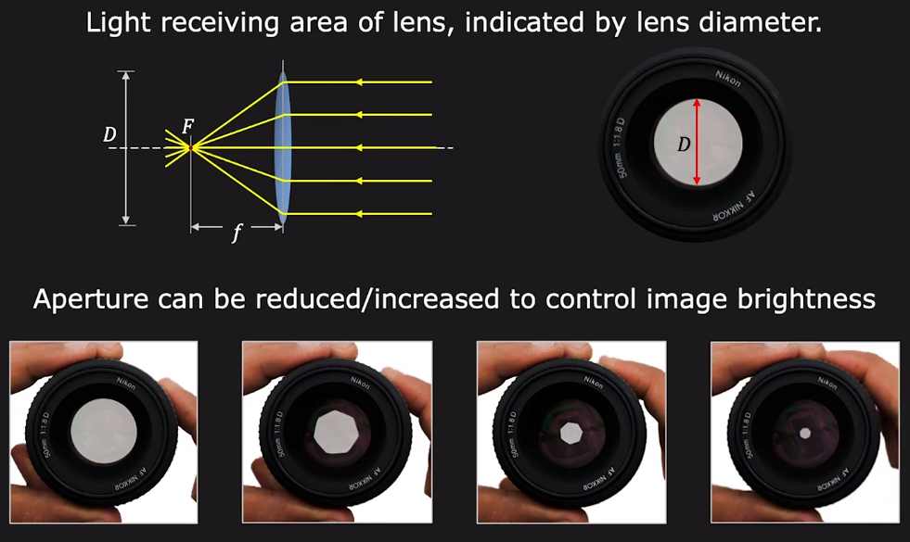
Aperture of Lens

Slide 3
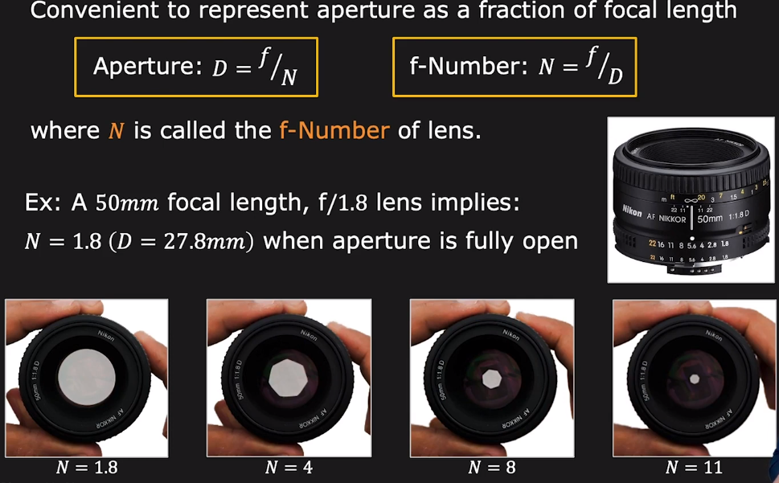
f Number(f-stop/f-ratio) of Lens

Slide 4
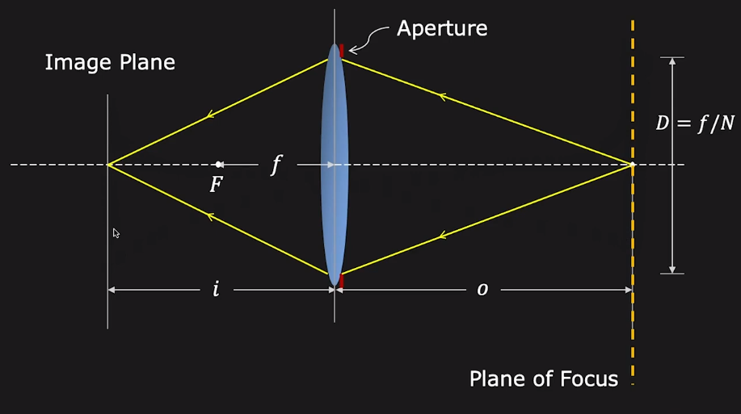
Lens Defocus

Slide 5
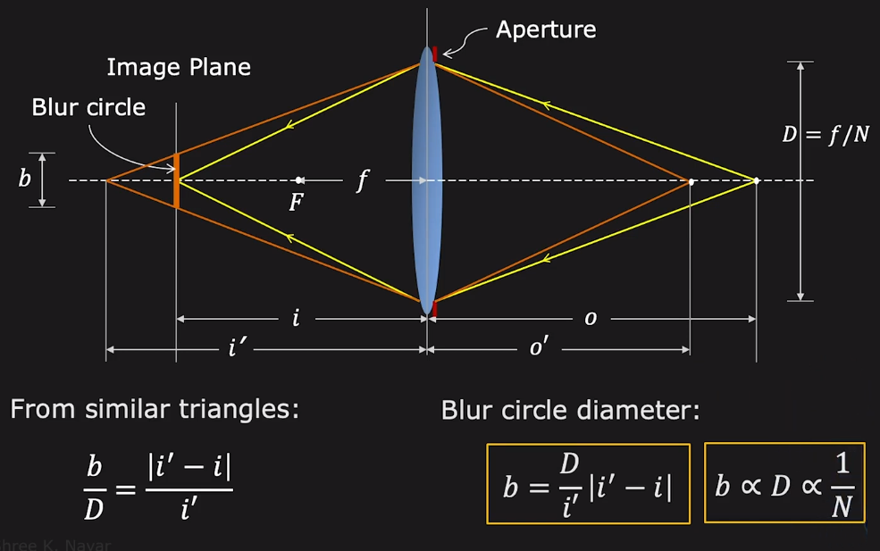
Lens Defocus

Slide 6
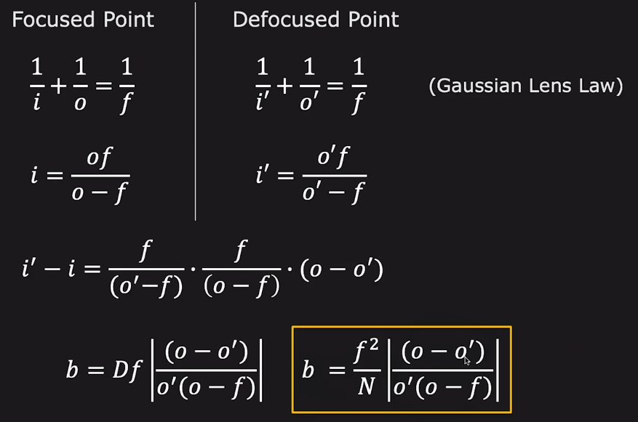
Blur Circle

Slide 7
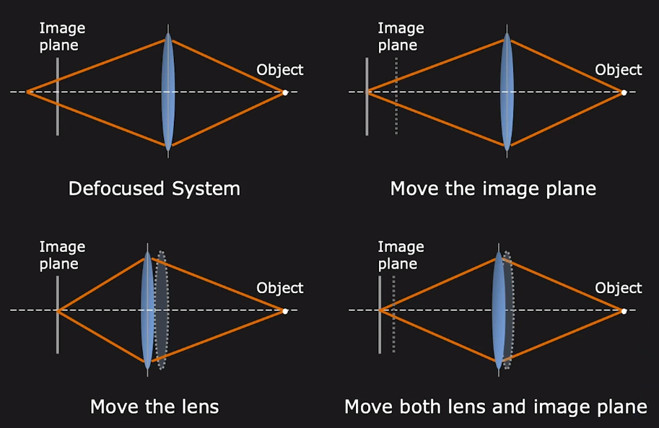
Focusing

Slide 8
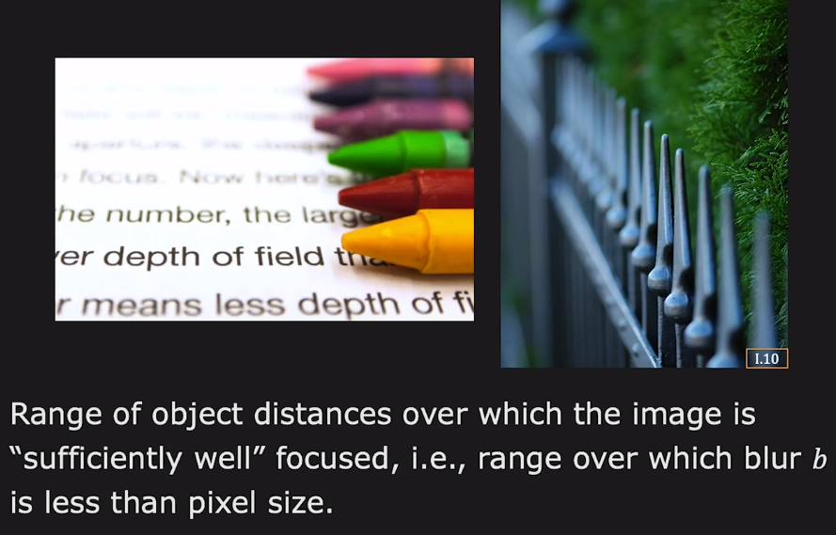
Depth of Field (DoF)

Slide 9
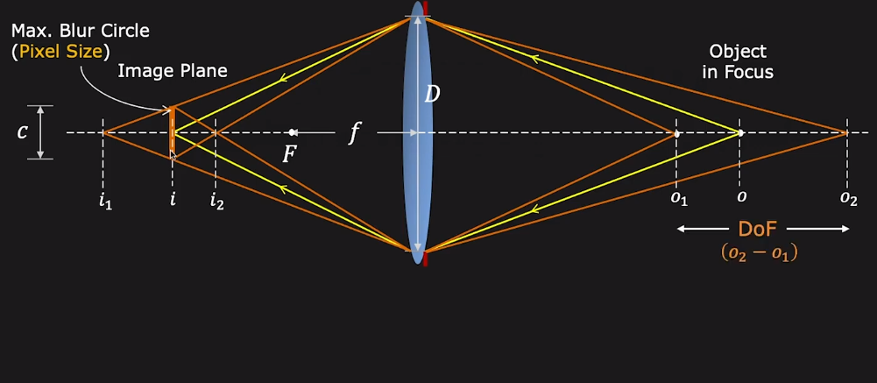
Depth of Field (DoF)

Slide 10
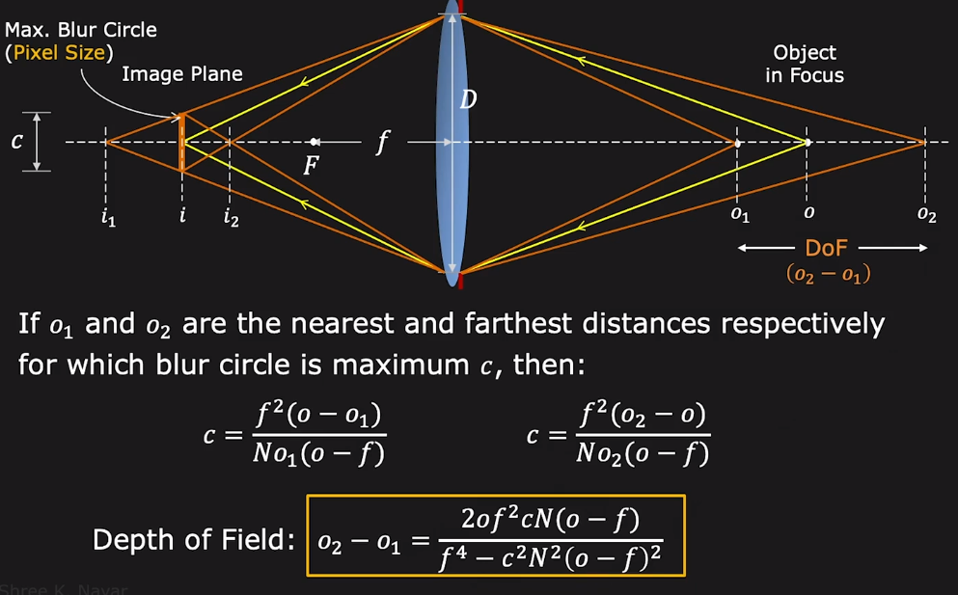
Depth of Field (DoF)

Slide 11
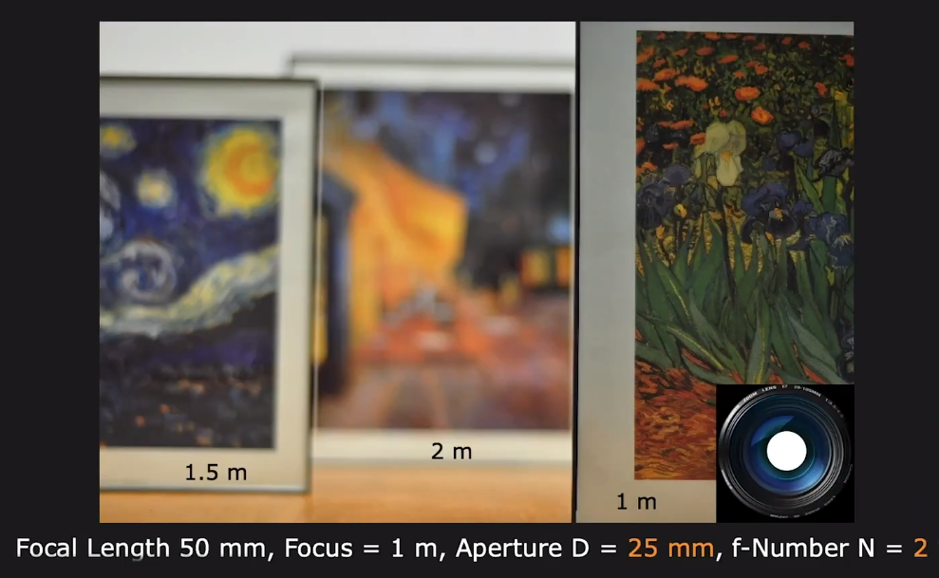
Aperture Size: DoF vs Brightness

Slide 12
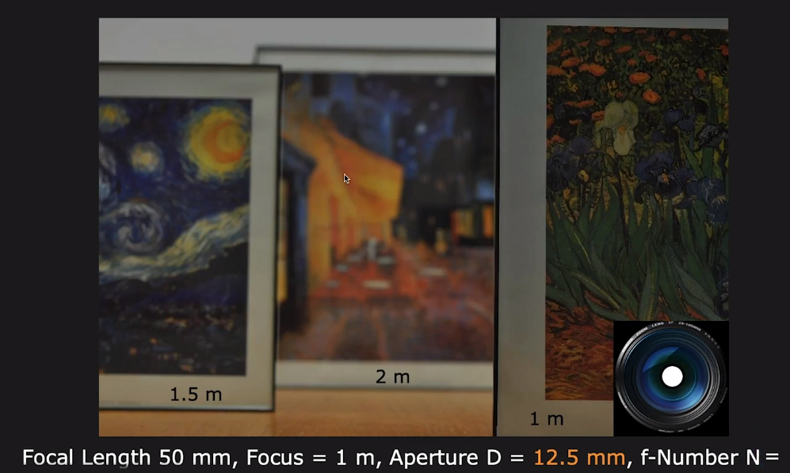
Aperture Size: DoF vs Brightness

Slide 13
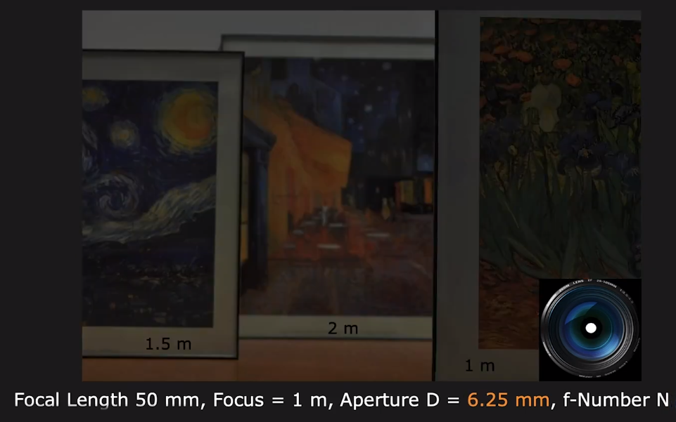
Aperture Size: DoF vs Brightness

Slide 14
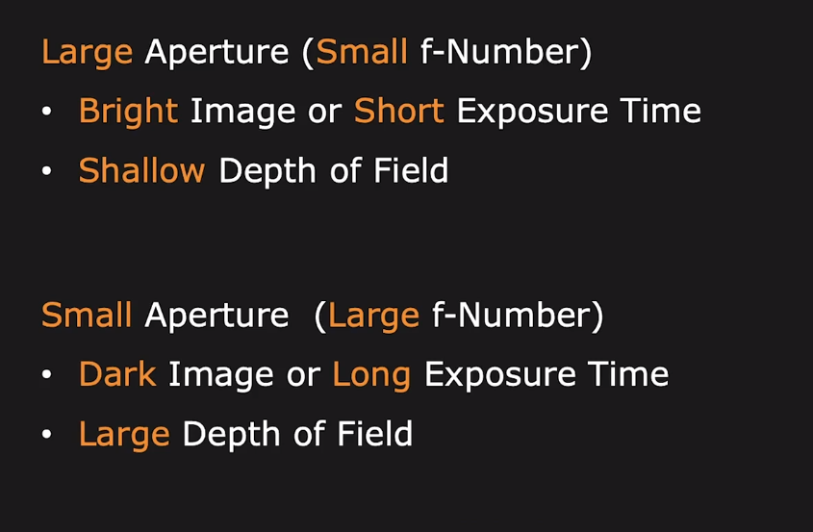
Aperture Size: DoF vs Brightness

Slide 15
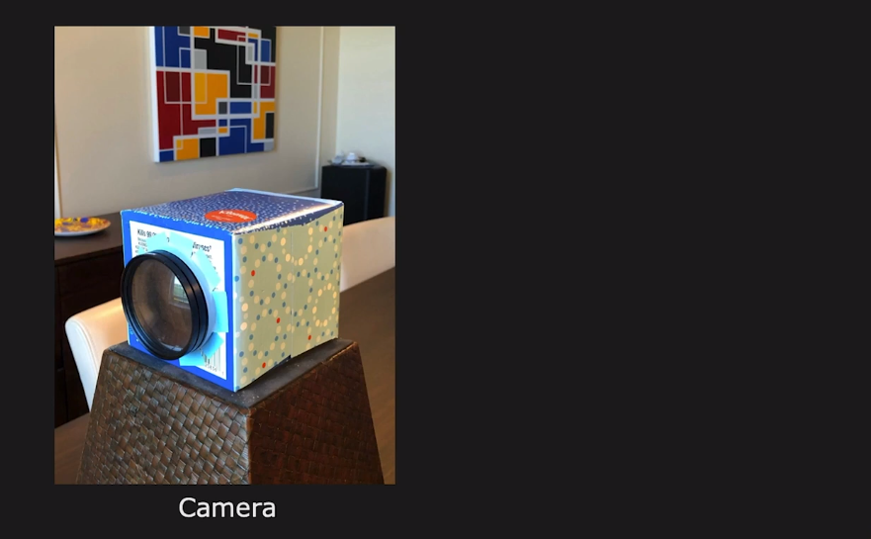
Tissue Box Camera

Slide 16
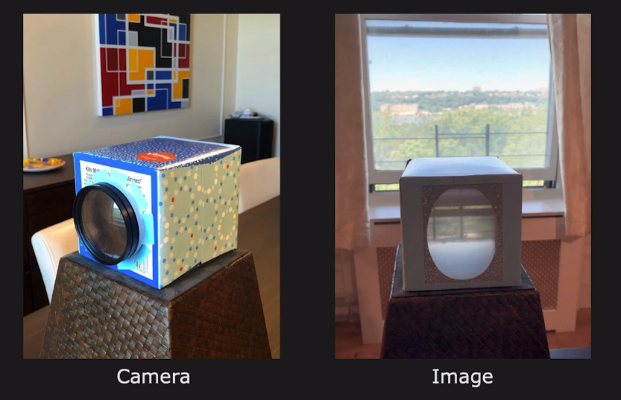
Tissue Box Camera

Slide 17
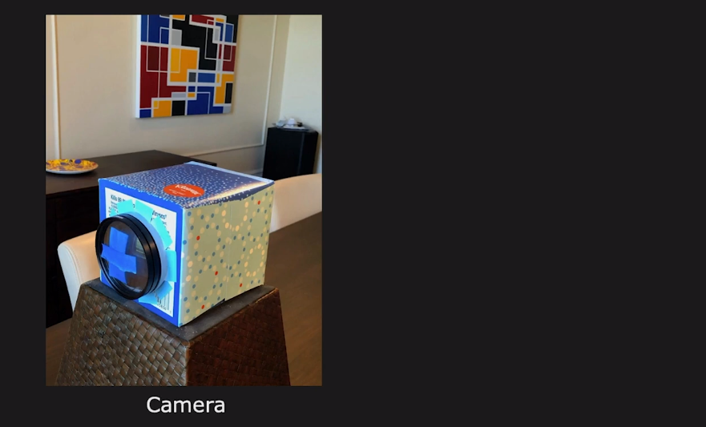
Blocking Camera Lens

Slide 18
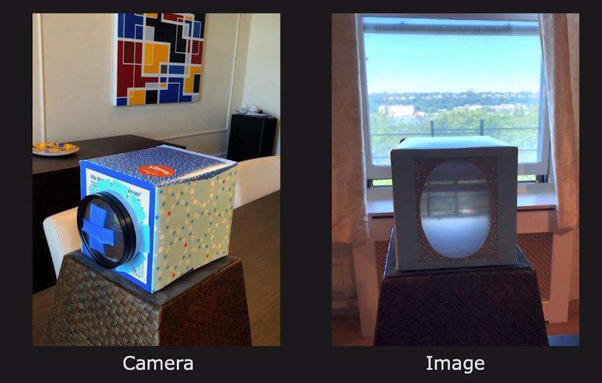
Blocking Camera Lens

Slide 19
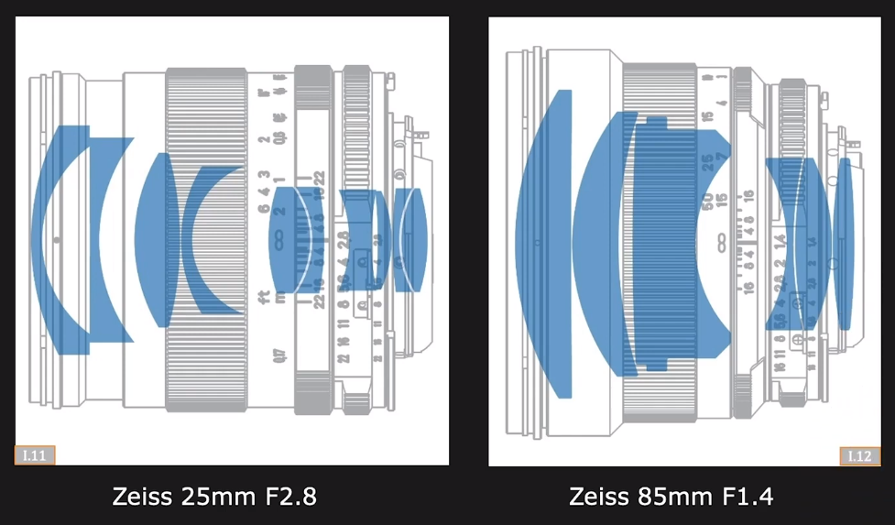
Compound Lenses

Slide 20
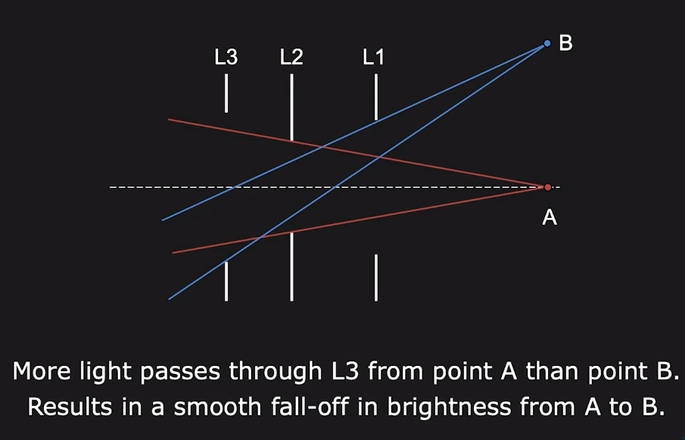
Vignetting

Slide 21
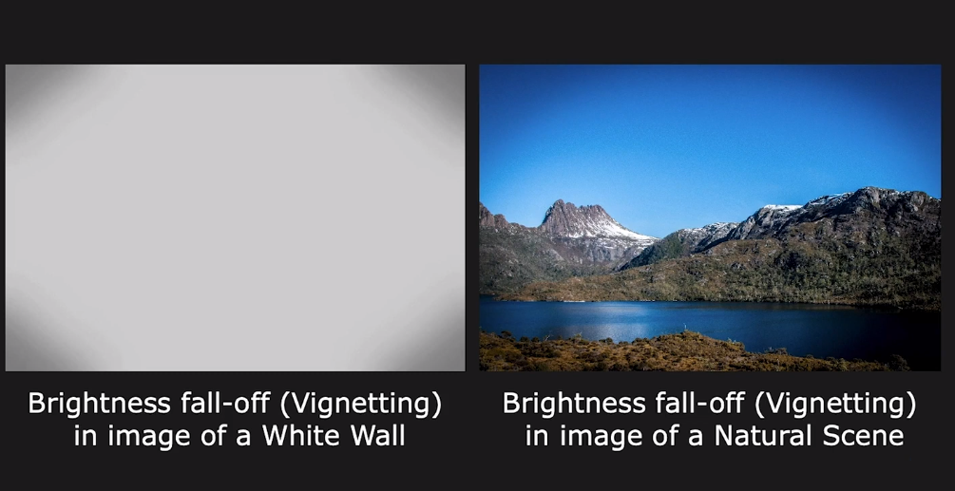
Vignetting

Slide 22
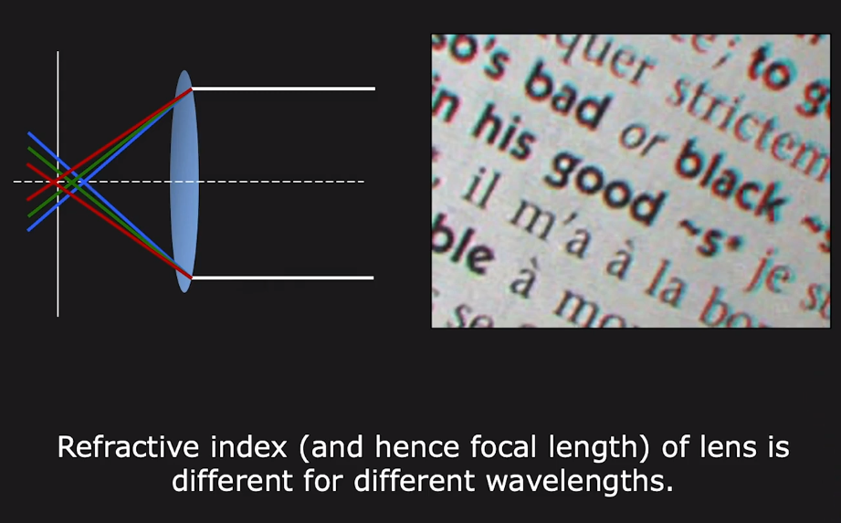
Chromatic Abberation

